Slide 1



Alternative Fuels for Freight Strategy: Presentation to the Western Gateway STB Board 7th December 2022
Tali Diamant
Associate Director, Atkins Transportation

Slide 2
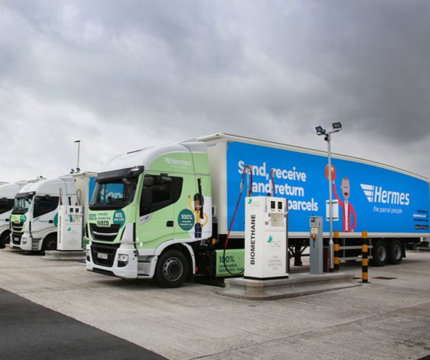
Background and Context
In 2019 Midlands Connect commissioned Atkins and Cenex to undertake research forecasting the uptake of alternative fuels.
This influential study, which included a stakeholder survey, and identification of high level cluster locations for refuelling infrastructure, was well received by the industry.
In 2022 Western Gateway and Peninsula Transport commissioned Atkins and Cenex to repeat elements of the study for the South West of England, following the completion of their Freight and Logistics Strategy.
Notes:
Consistent approach to understanding future needs

Slide 3




Methodology
Policy Review
Stakeholder Engagement
Fuel Uptake Forecasting
Refuelling Locations
Alternative Fuels for Freight Strategy

Slide 4
Literature and Policy Review
Review Key Policy Literature
Inform Alternative Fuel Strategy
Influence Future Policy
Existing policy and legislation analysed to understand the context within which the Alternative Fuels for Freight strategy will be positioned
      National Policy e.g. The Road to Zero, Decarbonising Transport – A Better, Greener Britain, Future of Freight : a long-term plan
      Regional Policy e.g. Peninsula Transport: Vision, Western Gateway’s Strategic Transport Plan, South West Freight Strategy
      Local Policy e.g. local authority strategies

Slide 5
Literature and Policy Review – Findings
National Policy
Clear targets have been set, but achievement of these targets is reliant upon local and regional authorities.
Regional Policy
Some aspects of policy are still emerging, however ambitions are clear and collaborative working established.
Local Policy
Limited policy on freight and decarbonisation. Declaration of climate emergencies demonstrates intent.
Notes:
Freight movements are regional – focus at STB level, but interaction between SRN facilities, large urban conurbations, and key freight origins/destinations. Greater interaction is needed across the three levels of policy to ensure delivery to avoid creation of policy in isolation.

Slide 6

Engagement Findings
Stakeholder Workshops held during July
Survey of freight and logistics organisations operating in South West
Workshops very valuable for outlook on government decarbonisation and EV strategy development
Survey had limited responses and was not representative of all stakeholders but provided some insight into challenges facing freight decarbonisation

Slide 7
Engagement Findings
Sustainability, safety and reliability most important factors when acquiring vehicles
Cost of zero emission vehicles and their performance were major perceived challenges
Primary concern: risk of investing in a technology which falls out of favour in the future
Negative opinion of infrastructure in the region: lack of planned grid enhancements, lack of planned infrastructure, restricts achievement of decarbonisation goals
Battery EV and Hydrogen most popular fuel types
Lack of clarity and certainty regarding ownership and delivery of national level policy

Slide 8
Alternative Fuels Uptake
Of the two possible scenarios for the change to the UK’s HGV fleet, our recommendations for refueling locations are based on the Net Zero pathway required by the Government’s Net Zero strategy.

Slide 9
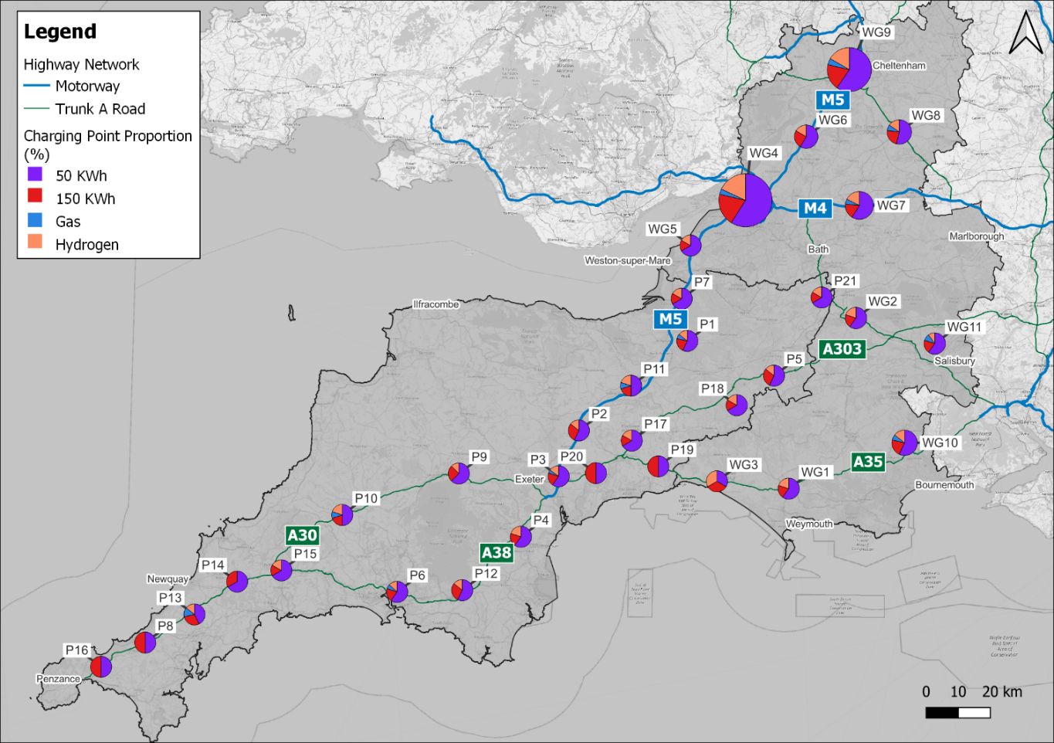
Potential Refuelling Locations – 2040 High Uptake Scenario
Notes:
Freight and logistics clusters identified using DfT Lorry Parking Survey dataset
Locations within 5km of A-roads and motorways clustered, with demand apportioned using NTMv5 flows

Slide 10
Study Findings
Map shows the existing freight sites this study recommends are converted to alternative refueling sites to meet 2040 high demand scenario.
Refueling locations are best provided at existing facilities (such as lorry parks, logistics hubs, and diesel stations) capable of accommodating HGVs.
Refueling locations have been identified based upon catchment area for logistics movements, site HGV capacity, and demand for each fuel type.
The next stage of this work will refine and prioritise sites based upon projected fuel uptake and related site suitability, freight flows, and the strategic strength of locations.
DfT currently does not hold data on freight and logistics facilities in north Devon. Therefore, we have been unable to recommend suitable sites within this sub-region.

Slide 11
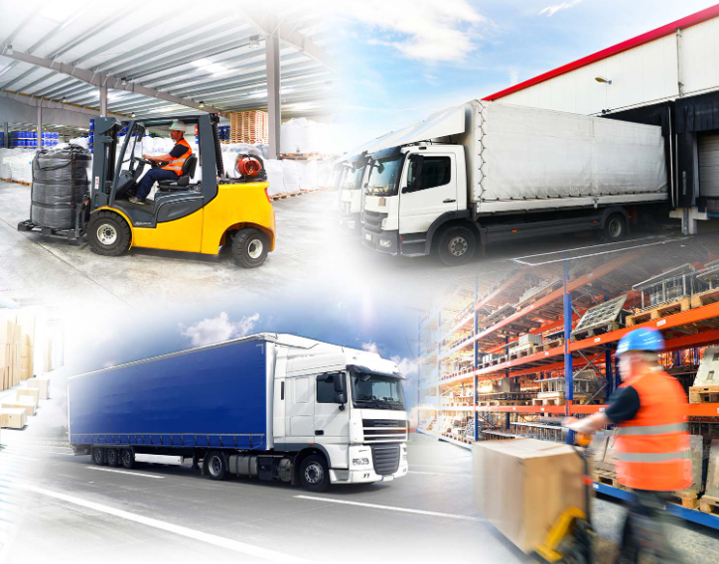
Recommendations
Work with other public sector organisations and the freight and logistics industry to identify ownership and key accountabilities for the decarbonisation of the industry.
Work with stakeholders to ensure the development of a cohesive refuelling network, which meets the needs of freight and logistic operators.
Influence the policy development processes of partner local authorities to ensure freight and logistics see greater representation.
Investigate the potential need for upgrades to electricity infrastructure.
Investigate additional refueling sites in locations without established freight facilities.
Develop and prioritise the suggested refuelling locations identified by this study.

