Slide 1
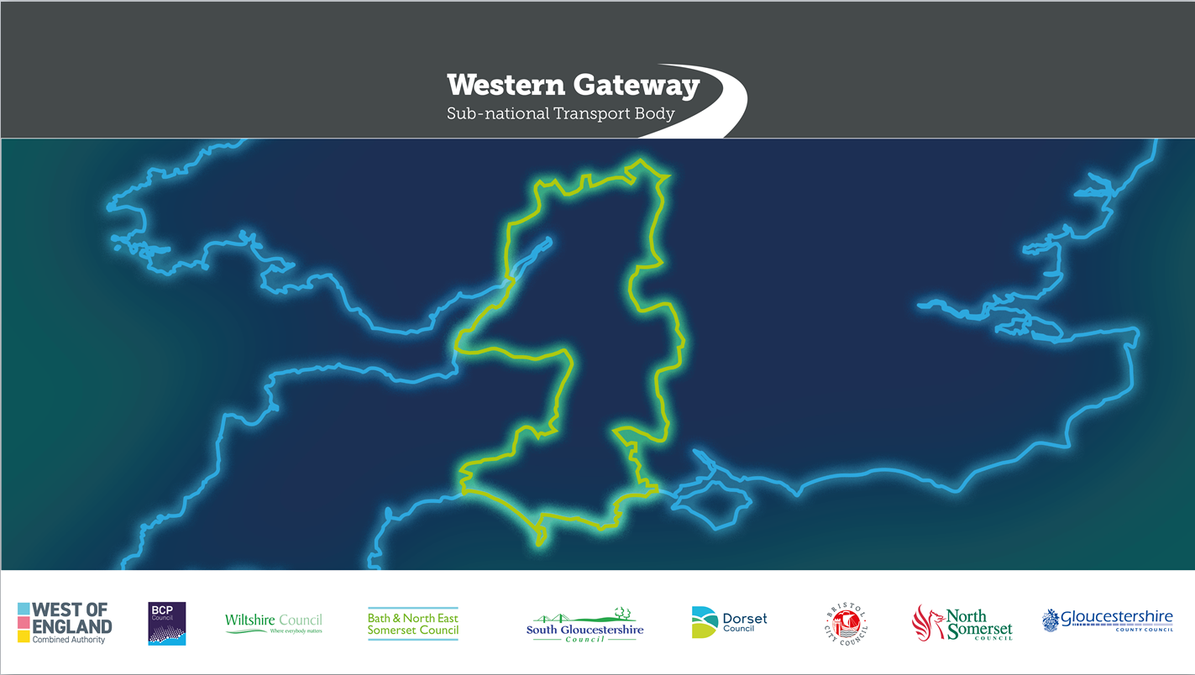
Western Gateway
Board Meeting
28 June 2023

Slide 2
Paper A: Coach Strategy – objectives
Improve urban and rural coach connectivity (including new routes) and integration
Encourage adoption of new technologies.
Develop easier and seamless access to information, purchasing tickets and accessing coach services to make coaches a more attractive and inclusive mode of transport.
Improve coach stops, interchanges, drop-off and layover parking facilities, including better facilities for drivers, making them more attractive places to wait, rest and interchange.
Increase engagement and encourage more coordinated and transparent decision-making and action to support the long-term resilience and vitality of the region’s coach sector.

Slide 3
Paper A: Coach Strategy
Six strategic themes identified and 36 interventions grouped around them

Slide 4
Paper A: Coach Strategy – programme for 2023/24
Data collection – further research and data gathering undertaken
Passenger awareness campaign for coach users
Set up a South West Coach Sector Steering Group – to follow a similar format to the successful South West Freight Forum
Explore in more detail the potential for the three new coach routes as set out in Appendix One

Slide 5
Paper A: Coach Strategy – Potential new routes
Bournemouth/ Poole/ Christchurch conurbation with Bath and Bristol

Slide 6
Paper A: Coach Strategy – potential new routes
Cheltenham/Gloucester to Bristol

Slide 7
Paper A: Coach Strategy – potential new routes
Cheltenham to Bournemouth

Slide 8
Paper A: Coach Strategy recommendations
The members of the Board are recommended to:
Approve the Coach Strategy.
Approve the programme of interventions as set out in section 4.2.
Delegate the Programme Team and Senior Officers Group to take forward the programme of interventions

Slide 9
Paper B: Alternative Fuels for Freight
Revised version of the report following comments and suggestions made at the 7 December 2022 Board
Matt Smith from Atkins is here to present
Issue | How addressed | Section in revised Strategy
Maritime and use of ports | New section on Maritime and Aviation added and ports included as locations for refuelling/recharging | 10.3.2 and 15.1
Rural nature of the region | New section on Impacts of Rurality added | 14.2.2
Planning blight | New section on Planning added. | 14.2.5
Source of energy | New section on Energy demand and sourcing added | 14.2.7
Lithium and cobalt | New section added on Raw material availability added | 14.2.6
Agriculture | New section added and recommendation to explore farm centred refuelling hubs | 10.4 and 19.2
Network gaps | Chapters 15 and 16 take a new approach to locations of hydrogen refuelling and EV charging stations | Figures 17-11, 17-14 and 19-1

Slide 10
Paper B: Alternative Fuels for Freight - recommendations
The members of the Board are recommended to:
I. Approve the revised report on Alternative Fuels for Freight.
II. Delegate the Programme Team and Senior Officers Group to take forward the shortlisting of potential locations for hydrogen refuelling and electric vehicle charging stations

Slide 11
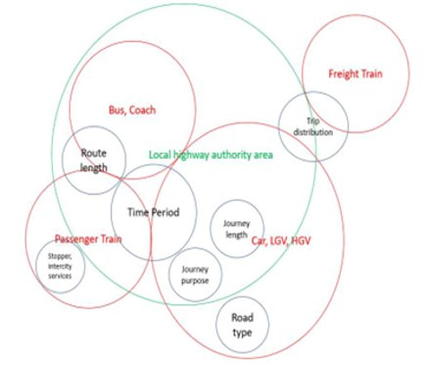
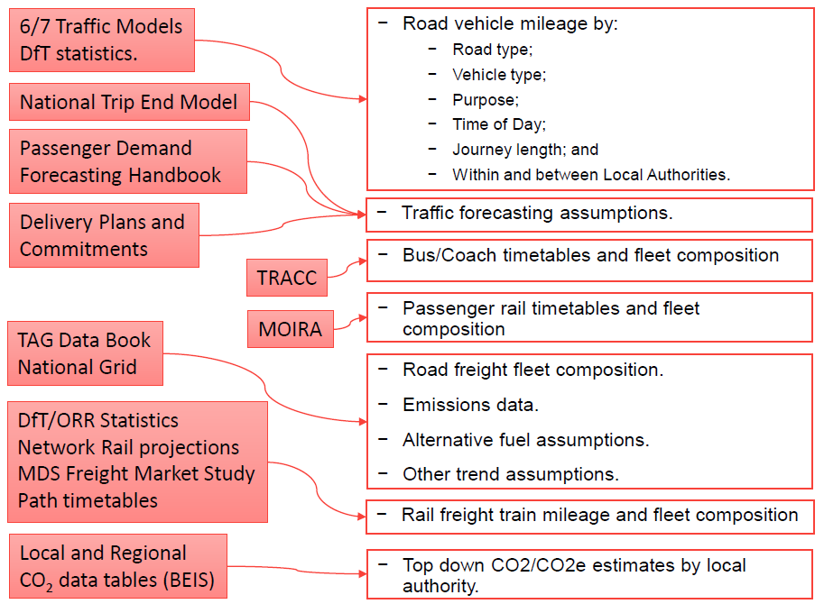
Carbon Baseline and Forecasting Tool: Background
Purpose – to inform the WGSTB Strategic Transport Plan and LTPs being developed by WGSTB authorities.
Methodology:
  Bottom-up / Slice & Dice approach
  2019 baseline year
  2030, 2040 and 2050 forecast years
  Do Minimum and Do Something (BAU/Central Case) scenarios
  Excel spreadsheet tool
Notes:
The purpose of the tool is to provide a bottom-up carbon emission baseline for transport emissions in the WGSTB area. The results of the baseline are also broken down into categories (for example journey mode) and aligned to historical carbon data by local highway authority available from the Department for Business, Energy & Industrial Strategy (BEIS).
Raw traffic data for the entire road network, operational tram, and rail data and WEBTAG emissions data (including fuel consumption rates, fuel type and associated emissions factors → Bottom up approach that provides a detailed emissions estimate for the entire transport network within the area and provides a detailed breakdown of various emission splits, including emissions by road type and trip genesis

Slide 12
Carbon Baseline and Forecasting tool:
Levers
Lever settings and values are based on available evidence and judgements of TDCM developer where the minimum and maximum range levels are not known. The user is responsible for the sensible selection and packaging of intervention levers and their range of variation.
45+ Incorporated ‘Levers’ to see the effect of different interventions/ measures on transport carbon emissions
  Shift modes
    Shared mobility
    Modern Public transport
    Street design and access restrictions
    Fiscal measures
  Switch fuels
    Electric vehicle charging infrastructure
    Conversion of fleets
  Substituting trips
    Active travel infrastructure (both passenger and freight)
    Land use planning
    IT Infrastructure

Slide 13
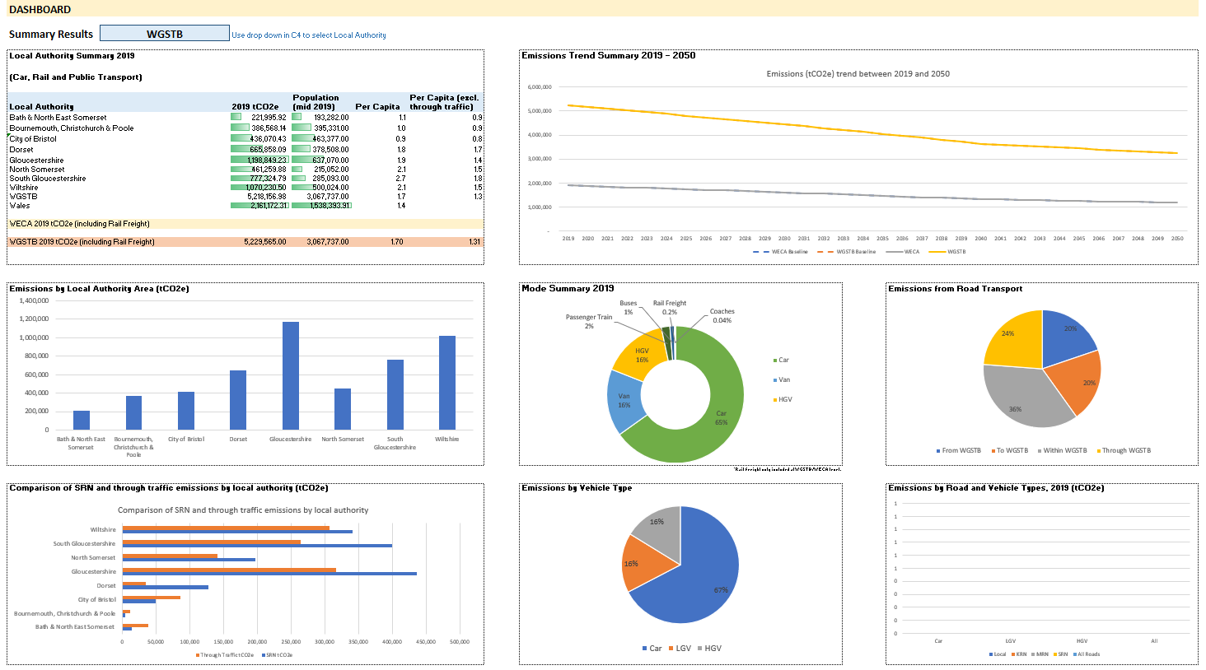



Carbon Baseline & Forecasting Tool: Dashboard
Notes:
The dashboards and visualisation provide easy to read graphics that can be used to build business cases and the detailed data tables can also be used as evidence base.

Slide 14
Carbon Baseline & Forecasting Tool: Utilisation
Quantifying carbon reduction
Demonstrating the challenge of decarbonisation
Sensitivity testing
Developing local transport plans
It can be used at a strategic level or operational depending on the desired level of detail
Focus on measures that will have the greatest influence
Notes:
This model can be used for a variety of purposes, especially as it is tailored to the specific Local authorities and a birds eye view of WECA and WGSTB regions can also be viewed. Allows LA’s to see where they stand within the wider region in terms of Carbon emissions. Some of the drivers to utilise this tool include:
Assessing how different decarbonisation targets may be achieved
Useful to see if a policy area is not pursued, which measures need to be pushed in order to achieve targets.

Slide 15
Carbon Baseline & Forecasting Tool: Roll Out
Soft Launch
Engagement & Feedback
Hosting the tool in a secure shared platform
More workshops

Slide 16
Paper C: Strategic Transport Plan revised programme
28 June 2023 Revised programme for Strategic Transport Plan and early results on the results of the Issues & Opportunities engagement to the Western Gateway Board meeting.
28 Sept 2023 Draft Strategic Transport Plan (using the results of the Issues & Opportunities engagement) to the Board for approval for public consultation.
Oct - Nov 2023 Public consultation on the draft Strategic Transport Plan begins
Jan/Feb 2024 Revised Strategic Transport Plan adopted by the Board

Slide 17
Paper C: Strategic Transport Plan – Issues & Opportunities
70% of the responses agree with the issues identified, a third of the responses were from key stakeholders.
Majority agree that Achieving Net Zero to be the Top priority and especially decarbonisation of transport.
Recurring view that the Issues & Opportunities Paper favours road building and Business as Usual while lacking practical commitment to public transport and rail improvements.
For the Issues in our region section, connectivity should focus on rail rather than road. Corridors to be viewed as transport corridors rather than mono-modal corridors

Slide 18
Paper C: Strategic Transport Plan – Issues & Opportunities
Support for the opportunities mentioned with Rail being ranked highest in terms of priority, followed by Bus and Coach, Alternative Fuels and Demand Management.
STB encouraged to adopt a different and collaborative approach for seeking solutions to achieve the desirable integrated outcomes for the region.
Concern that it is unclear how achieving Net Zero by minimising road use will be balanced against the need for economic growth. The Strategic Plan will need to address this. Suggested that better integration with Active Travel, Public Transport and Technology will be key to success and should be the focus

Slide 19
Paper C:Recommendations
The members of the Board are recommended to:
Approve the latest programme for producing and approving the Western Gateway Strategic Transport Plan.
Note the emerging results from the engagement on the Issues & Opportunities paper.

